Slide 1
Project 3 Phase 1: Implementation Dijkstra algorithm for a mobile Robot
This is a group project.
Due Date (phase1 + phase2) – April 5th, 11.59 PM

Slide 2
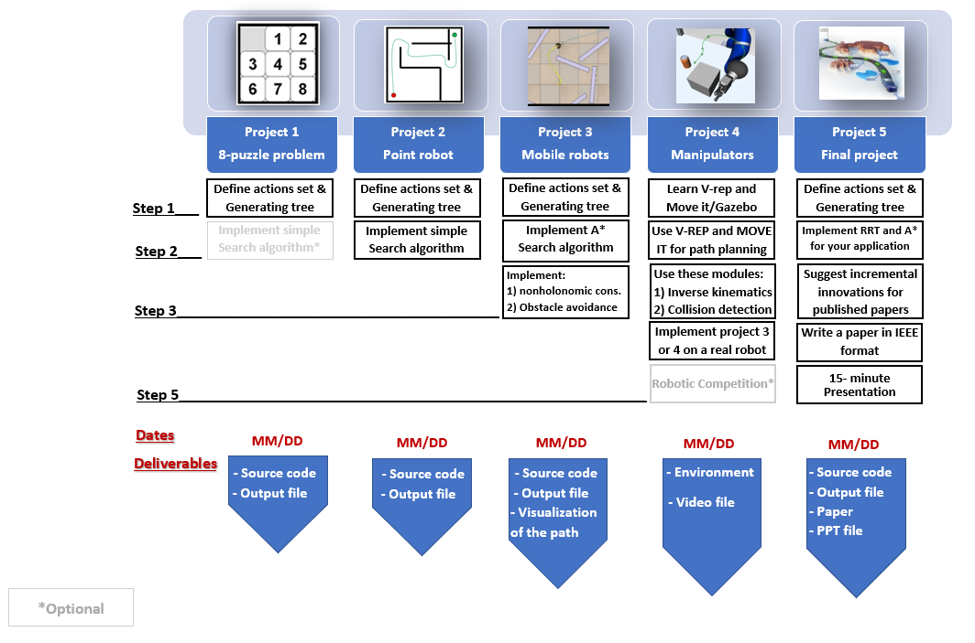

Slide 3
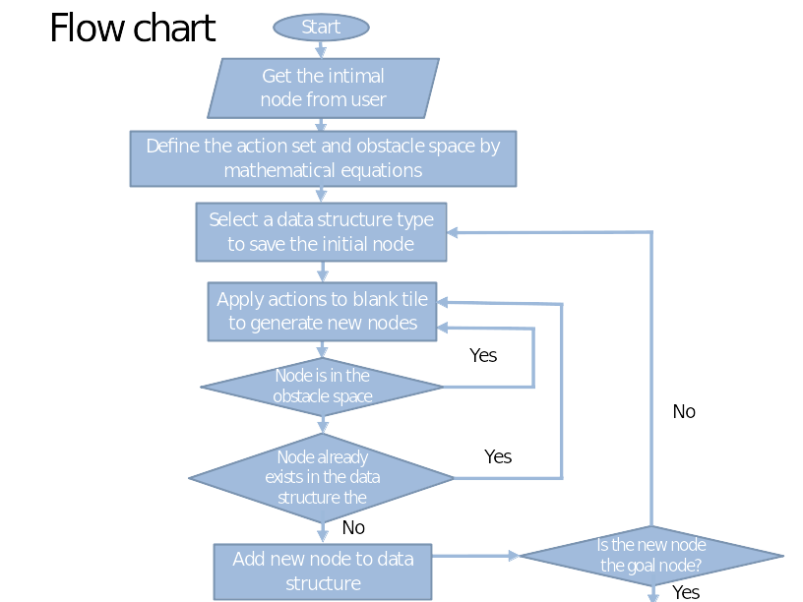
Perform the actions and generate new nodes
Add new node with it's corresponding parent and cost information to the data structure

Slide 4
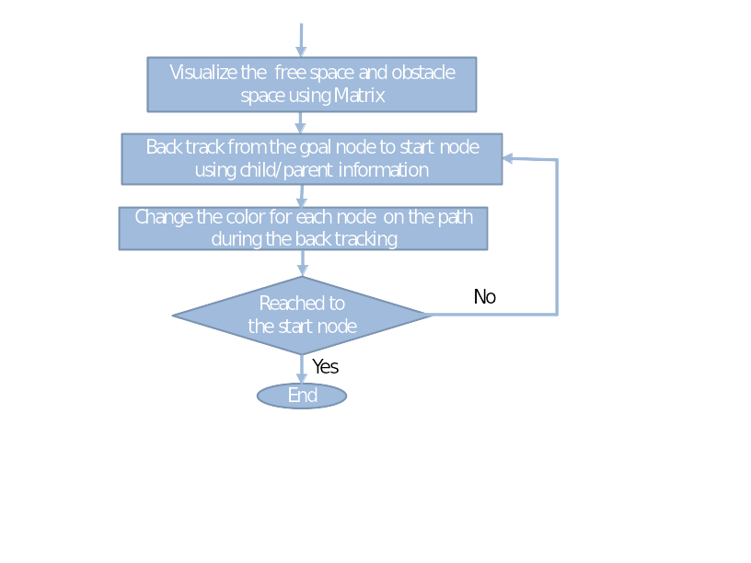

Slide 5
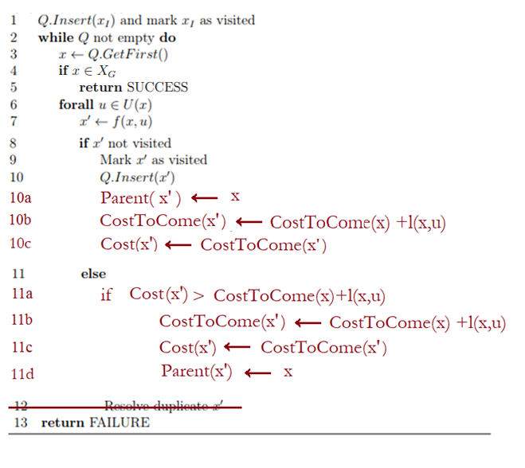
Pseudo code for Dijkstra Search
Going through the pseudo code is highly recommended

Slide 6
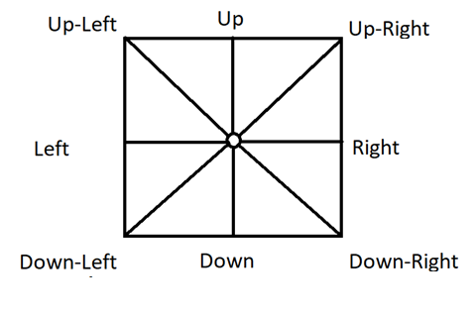
Project 2 Description (Retain from previous project)
Project Assumption: Workspace is an 8 connected space, that means now you can move the robot in up, down, left, right & diagonally between up-left, up-right, down-left and down-right directions.
Action sets= {(1,0), (-1,0), (0,1), (0,-1), (1,1), (-1,1),(1,-1),(-1,-1)}

Slide 7
Project 3 Description
1) Check the feasibility of all inputs/outputs (if user gives start and goal nodes that are in the obstacle space they should be informed by a message and they should try again). (retain from previous project)
2) Implement Dijkstra’s Algorithm to find a path between start and end point on a given map for a mobile robot (radius = 10; clearance = 5).
3) Your code must output an animation of optimal path generation between start and goal point on the map. You need to show both the node exploration as well as the optimal path generated. (Some useful tools for simulation are OpenCV/Pygame/Matplotlib). (retain from previous project)

Slide 8
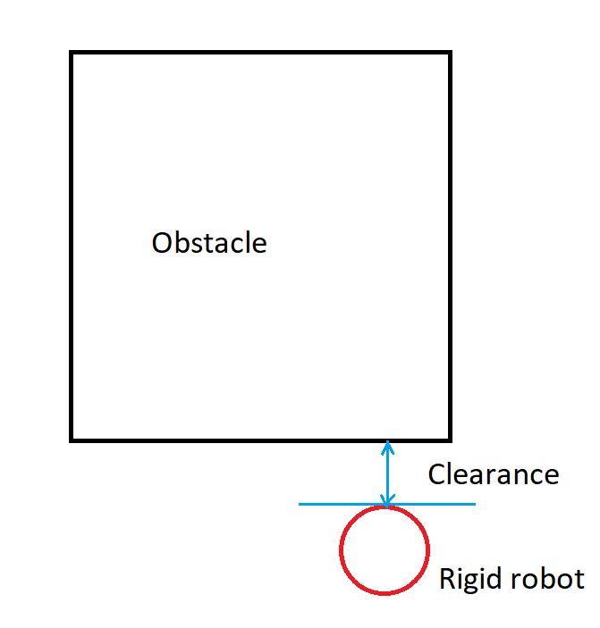
Clearance
Clearance is a maximum distance between the obstacle and the extreme point of the rigid robot.

Slide 9
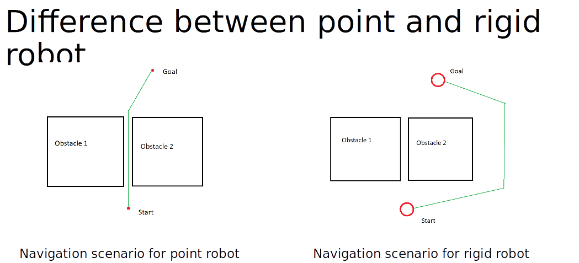

Slide 10
Visualization
https://drive.google.com/file/d/1OTvRGCmQ35oXbf5HEe70rL6czHS3PJf5/view

Slide 11
Step 1) Define the actions in a mathematical format (Retain from previous project)
Use can use the same data structure from project 1 to store the node information.
Write 8 subfunctions, one for each action. The output of each subfunction is the state of a new node after taking the associated action.
Action sets= {(1,0), (-1,0), (0,1), (0,-1), (1,1), (-1,1),(1,-1),(-1,-1)}

Slide 12
Step 2) Find mathematical representation of free space (Retain from previous project)
Use Half planes and semi-algebraic models to represent the obstacle space.

Slide 13
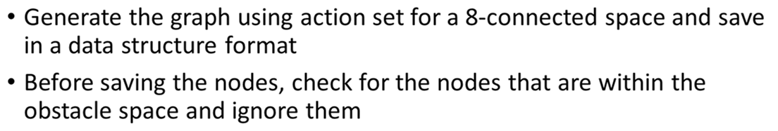
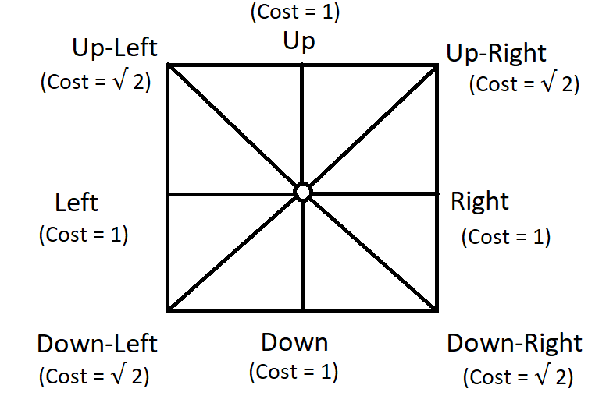
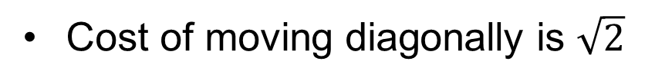
Step 3) Generate the graph (Retain from previous project)
vb
Cost of moving diagonally is $\sqrt{2}$

Slide 14
Step 4) Find the optimal path (Backtracking) (Retain from previous project)
Write a subfunction that compares the current node with the goal node and return TRUE if they are equal.
While generating each new node this subfunction should be called
Write a subfunction that once the goal node is reached, using the child and parent relationship, it backtracks from the goal node to initial node and outputs all the intermediate nodes.

Slide 15
Step 5) Represent the optimal path (Retain from previous project)
Show optimal path generation animation between start and goal point using a simple graphical interface. You need to show both the node exploration as well as the optimal path generated.
The visualization of (exploration and optimal path) should start only after the exploration is complete and optimal path is found.
Note: A separate document will be provided later this coming week to describe this step

Slide 16
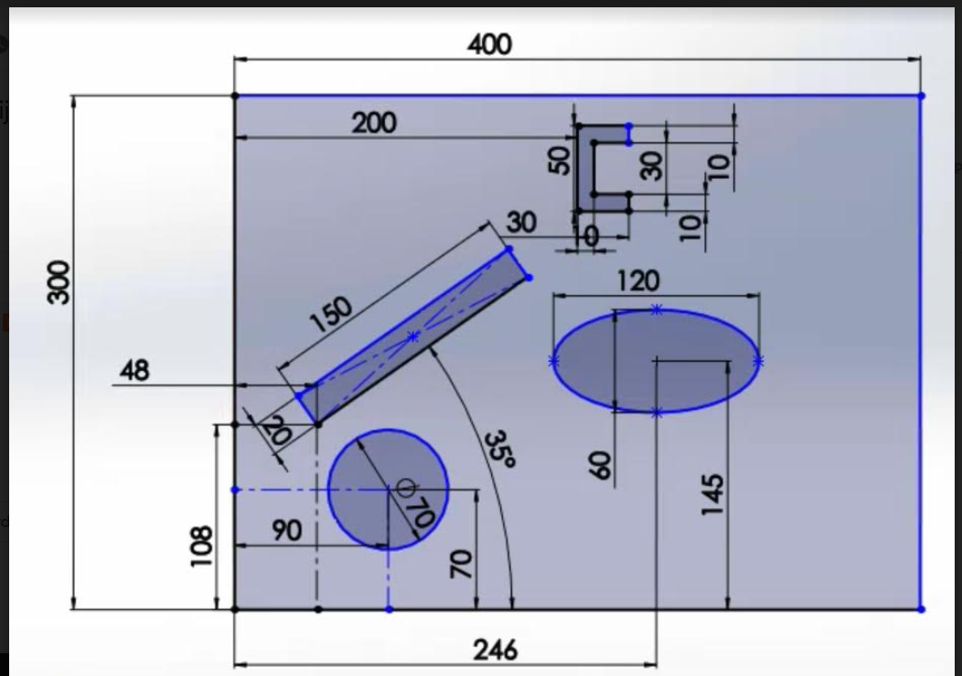
Final Map (towards submission)
y
x

Slide 17
Deliverables
Deliverables:
ReadMe.txt (Describing how to run the code in a txt format)
Source files for
Student_name.py
GitHub repository link in the URL submission
Video recording (start and goal point can be random)
Note: The code should accept start and goal points from the user

